Slide 1

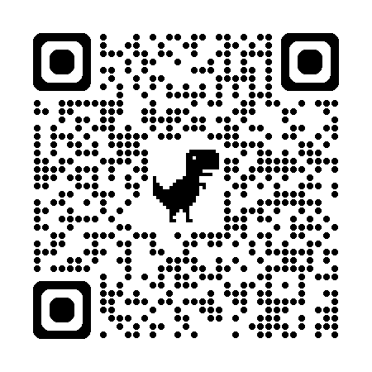
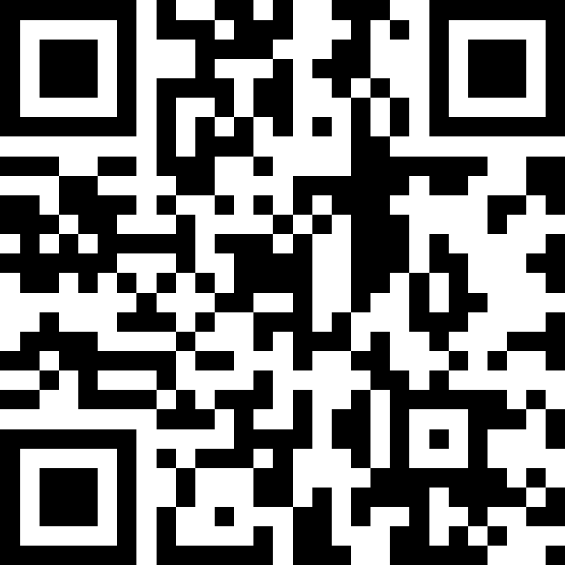
自然語言處理與應用 Natural Language Processing and Applications
Decoding Strategies
Instructor: 林英嘉 (Ying-Jia Lin)
2025/03/31
Course GitHub
Slido # NLP_0331

Slide 2
Outline
Recap: Language Generation
Decoding Strategies
Greedy Decoding
Beam Search
Top-k / Top-p Sampling
Decoding Strategies and Evaluations for Natural Language Generation

Slide 3
Natural Language Generation (NLG)
Natural language generation (NLG) is a process that that outputs text.
NLG includes a wide variety of NLP tasks.
Machine Translation
Abstractive Summarization
Dialogue Generation
(e.g., ChatGPT)
Story Generation
Image Captioning
...
Decoding Strategies and Evaluations for Natural Language Generation

Slide 4
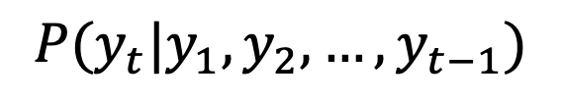
Recap: Language Model
(The next word)
y₈
$$P(y_{t}|y_{1},y_{2},…,y_{t−1})$$
Language Model
A model that assigns probabilities to upcoming words is called a language model.
The task involving predictions of upcoming words is language modeling.
y₁
y₂
y₃
y₄
y₅
y₆
y₇
Decoding Strategies and Evaluations for Natural Language Generation

Slide 5
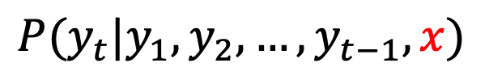
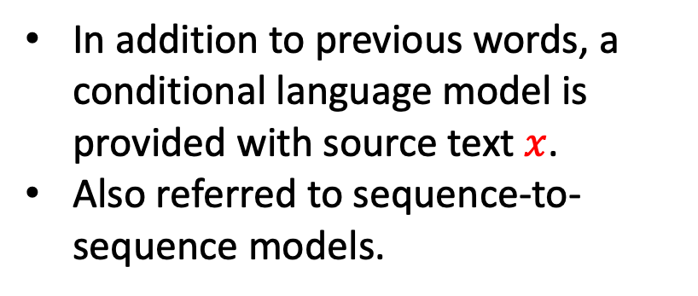
Recap: Conditional Language Model
In addition to previous words, a conditional language model is provided with source text $x$.
Also referred to sequence-to-sequence models.
$$P(y_{t}|y_{1},y_{2},…,y_{t−1},x)$$
(Target output)
y₁
y₂
y₃
y₄
y₅
y₆
y₇
y₈
Encoder
Decoder
Attention
x₁
x₂
x₃
x₄
x₅
x₆
x₇
x₈
_
y₁
y₂
y₃
y₄
y₅
y₆
y₇
(Start)
Decoding Strategies and Evaluations for Natural Language Generation

Slide 6
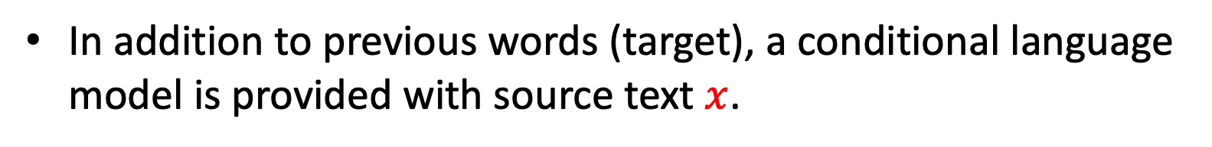
Tasks of Conditional Language Model
In addition to previous words (target), a conditional language model is provided with source text $x$.
 | Source | Target
Machine Translation | Language A | Language B
Summarization | Long Text | Concise Text
Dialogue Generation | User Input | Desired User Input
...
Decoding Strategies and Evaluations for Natural Language Generation

Slide 7
How to train a (Conditional) Language Model?
First, you need a training corpus.
Example: I love reading books.
Language modeling (Unsupervised)
Machine Translation (Supervised)
I
love
I
love
reading
books
English
I
love
reading
我
愛
閱
讀
Chinese
I
love
reading
books
Decoding Strategies and Evaluations for Natural Language Generation

Slide 8
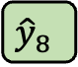
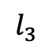
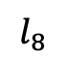
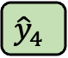
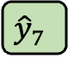
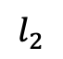
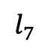
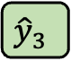
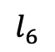
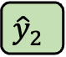
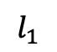
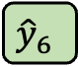
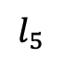
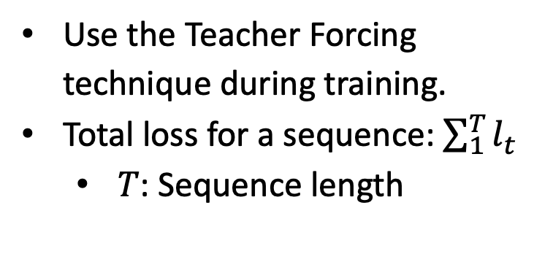
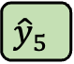
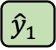
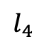
How to train a (Conditional) Language Model?
Teacher Forcing
Use the Teacher Forcing technique during training.
Total loss for a sequence: $\sum_{1}^{T}{l_{t}}$
$T$: Sequence length
y₁
y₂
y₃
y₄
y₅
y₆
y₇
y₈
$$l_{1}$$
$$l_{2}$$
$$l_{3}$$
$$l_{4}$$
$$l_{5}$$
$$l_{6}$$
$$l_{7}$$
$$l_{8}$$
Cross-
entropy
$${\hat{y}}_{1}$$
$${\hat{y}}_{2}$$
$${\hat{y}}_{3}$$
$${\hat{y}}_{4}$$
$${\hat{y}}_{5}$$
$${\hat{y}}_{6}$$
$${\hat{y}}_{7}$$
$${\hat{y}}_{8}$$
Encoder
Decoder
Attention
x₁
x₂
x₃
x₄
x₅
x₆
x₇
x₈
_
y₁
y₂
y₃
y₄
y₅
y₆
y₇
(Start)
Decoding Strategies and Evaluations for Natural Language Generation

Slide 9
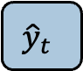
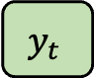
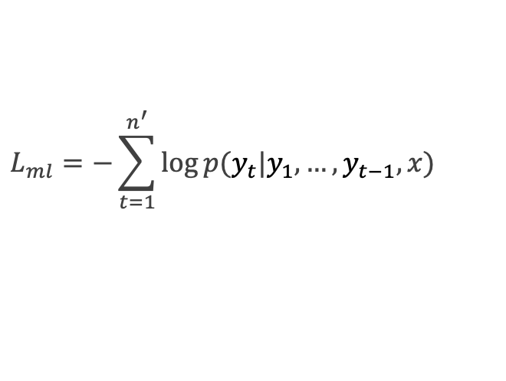
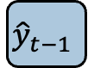
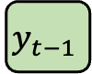
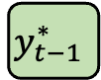
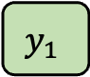
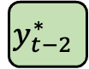
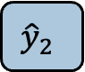
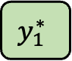
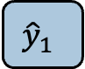
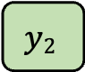
Teacher Forcing – Training Time
$$L_{ml}=−\sum_{t=1}^{n^{′}}{\log{p(y_{t}|y_{1},…,y_{t−1},x)}}$$
During training:
$${\hat{y}}_{1}$$
$${\hat{y}}_{2}$$
……
$${\hat{y}}_{t−1}$$
$${\hat{y}}_{t}$$
Decoder
……
$$y_{1}$$
$$y2$$
$$y_{t−1}$$
$$y_{t}$$
Ground truth sequence
_
$$y_{1}^{∗}$$
……
$$y_{t−2}^{∗}$$
$$y_{t−1}^{∗}$$
(Start)
Decoding Strategies and Evaluations for Natural Language Generation
Notes:
During training, decoder output y hat at each decoding time step
With the ground truth input the produce the output token

Slide 10
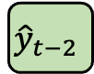
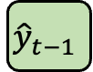
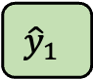
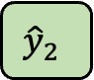
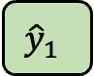
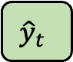
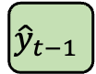
Teacher Forcing – Testing Time
During testing:
Output sequence
Advantage: stabilize training and increase performance
Question: How does the next word be determined?
$${\hat{y}}_{1}$$
$${\hat{y}}_{2}$$
……
$${\hat{y}}_{t−1}$$
$${\hat{y}}_{t}$$
Decoder
_
$${\hat{y}}_{1}$$
……
$${\hat{y}}_{t−2}$$
$${\hat{y}}_{t−1}$$
(Start)
Decoding Strategies and Evaluations for Natural Language Generation
Notes:
However, during testing, the output y hat at each time step will be directly feed to the next time step as input

Slide 11
Decoding Strategies
Greedy Decoding
Beam Search
Top-k Sampling
Top-p Sampling

Slide 12
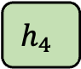
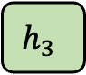
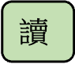
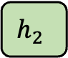
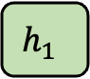
Greedy Decoding
Example: I love reading books.
Output sequence
我
愛
閱
$$讀$$
argmax
argmax
argmax
argmax
$$h_{1}$$
$$h_{2}$$
$$h_{3}$$
$$h_{4}$$
Decoder
_
我
愛
閱
(Start)
Decoding Strategies and Evaluations for Natural Language Generation

Slide 13
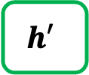
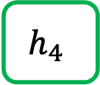
Greedy Decoding – Best Selection Process
Vocab
Prob
天
...
讀
...
哭
...
...
覽
...
玩
...
...
。
0.0001
...
0.600
...
0.0001
...
0.0003
...
0.300
...
0.05
...
...
0.0001
$$h_{4}$$
Classification Layer
Hidden size: Vocab_size
Decoder
$$h′$$
Vocab
size
_
我
愛
閱
(Initial)
Decoding Strategies and Evaluations for Natural Language Generation

Slide 14
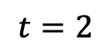



Problem of Greedy Decoding
Greedy decoding cannot undo!
Ground-truth: 我愛閱讀
Decoding Process
我
我
愛
我
愛
打
Mistake occurs
我
愛
打
球
More mistake occur
$$t=1$$
$$t=2$$
$$t=3$$
$$t=4$$
Decoding Strategies and Evaluations for Natural Language Generation

Slide 15
Re-thinking Greedy Decoding
Greedy decoding cannot undo!
Greedy decoding only provides one best choice at each time step.
How about providing more than one choices at each time step?
Beam Search
Decoding Strategies and Evaluations for Natural Language Generation

Slide 16

Beam Search
Set the `Beam size` (or `Beam width`) = 2
This means that the number of candidates will be preserved at each decoding time.
Beam size is a hyperparameter for beam search decoding.
At each decoding time step, a score is calculated via the following equation:
$$L_{ml}=−\sum_{t=1}^{n^{′}}{\log{p(y_{t}^{∗}|y_{1}^{∗},…,y_{t−1}^{∗},x)}}$$
*代表 (強調) 當前時間點生成機率最大的選項
Decoding Strategies and Evaluations for Natural Language Generation

Slide 17



Beam Search ($t=1$)
`Beam size` = 2
$$\log{p\left( \text{I} \right| \text{Start} )=}−0.7$$
I
At this decoding step, two choices are preserved.
_
(Start)
You
$$\log{p\left(\text{You}\right| \text{Start} )=}−0.9$$
Decoding Strategies and Evaluations for Natural Language Generation

Slide 18


Beam Search ($t=1$)
`Beam size` = 2
$$−0.7$$
I
At this decoding step, two choices are preserved.
_
(Start)
You
$$−0.9$$
Decoding Strategies and Evaluations for Natural Language Generation

Slide 19






Beam Search ($t=2$)
`Beam size` = 2
$$L_{ml}=−\sum_{t=1}^{T}{\log{p(y_{t}^{∗}|y_{1}^{∗},…,y_{t−1}^{∗},x)}}$$
$$−0.7+\log{p\left( \text{like} \right| \text{Start}\text{, }\text{I})=}−1.7$$
$$−0.7$$
like
Note the loglikelihood! Being close to zero is better!
I
At this decoding step, two choices are preserved, and the other two are discarded.
want
_
$$−0.7+\log{p\left( \text{want} \right| \text{Start}\text{, }\text{I})=}−2.9$$
$$−0.9+\log{p\left( \text{want} \right| \text{Start}\text{, }\text{You})=}−1.6$$
(Start)
want
You
are
$$−0.9$$
$$−0.9+\log{p\left( \text{are} \right| \text{Start}\text{,}\text{You})=}−1.8$$
Decoding Strategies and Evaluations for Natural Language Generation

Slide 20




Beam Search ($t=2$)
`Beam size` = 2
$$−1.7$$
$$−0.7$$
like
I
want
_
$$−2.9$$
(Start)
$$−1.6$$
want
You
are
$$−0.9$$
$$−1.8$$
Decoding Strategies and Evaluations for Natural Language Generation

Slide 21



Beam Search ($t=3$)
`Beam size` = 2
$$−1.7$$
to
$$−1.7+\log{p\left( \text{to} \right| \text{Start}\text{, }\text{I}\text{, }\text{like})=}−2.8$$
$$−0.7$$
like
I
books
$$−1.7+\log{p\left( \text{books} \right| \text{Start}\text{, }\text{I}\text{, }\text{like})=}−2.5$$
want
_
$$−2.9$$
$$−1.6$$
to
$$−1.6+\log{p\left( \text{to} \right| \text{Start}\text{,}\text{You}\text{, }\text{want})=}−2.9$$
(Start)
want
You
tea
$$−1.7+\log{p\left( \text{tea} \right| \text{Start}\text{, }\text{You}\text{, }\text{want})=}−3.8$$
are
$$−0.9$$
$$−1.8$$
Decoding Strategies and Evaluations for Natural Language Generation

Slide 22
Beam Search ($t=3$)
`Beam size` = 2
$$−1.7$$
to
$$−1.7+\log{p\left( \text{to} \right| \text{Start}\text{, }\text{I}\text{, }\text{like})=}−2.8$$
$$−0.7$$
like
I
books
$$−1.7+\log{p\left( \text{books} \right| \text{Start}\text{, }\text{I}\text{, }\text{like})=}−2.5$$
want
_
$$−2.9$$
$$−1.6$$
to
$$−1.6+\log{p\left( \text{to} \right| \text{Start}\text{,}\text{You}\text{, }\text{want})=}−2.9$$
(Start)
want
You
tea
$$−1.7+\log{p\left( \text{tea} \right| \text{Start}\text{, }\text{You}\text{, }\text{want})=}−3.8$$
are
$$−0.9$$
$$−1.8$$
Decoding Strategies and Evaluations for Natural Language Generation

Slide 23






Beam Search ($t=3$)
`Beam size` = 2
$$−2.8$$
$$−1.7$$
to
$$−0.7$$
like
I
books
want
$$−2.5$$
_
$$−2.9$$
$$−2.9$$
$$−1.6$$
to
(Start)
want
You
tea
are
$$−0.9$$
$$−3.8$$
$$−1.8$$
Decoding Strategies and Evaluations for Natural Language Generation

Slide 24





Beam Search ($t=4$)
`Beam size` = 2
$$−4.1$$
$$−2.8$$
read
$$−1.7$$
to
$$−0.7$$
like
watch
I
books
$$−3.2$$
want
$$−2.5$$
$$−3.3$$
and
_
$$−2.9$$
$$−2.9$$
$$−1.6$$
to
(Start)
party
want
You
tea
$$−3.5$$
are
$$−0.9$$
$$−3.8$$
$$−1.8$$
Decoding Strategies and Evaluations for Natural Language Generation

Slide 25
Beam Search ($t=4$)
`Beam size` = 2
$$−4.1$$
$$−2.8$$
read
$$−1.7$$
to
$$−0.7$$
like
watch
I
books
$$−3.2$$
want
$$−2.5$$
$$−3.3$$
and
_
$$−2.9$$
$$−2.9$$
$$−1.6$$
to
(Start)
party
want
You
tea
$$−3.5$$
are
$$−0.9$$
$$−3.8$$
$$−1.8$$
Decoding Strategies and Evaluations for Natural Language Generation

Slide 26





Beam Search ($t=5$)
`Beam size` = 2
$$−4.1$$
$$−4.8$$
$$−2.8$$
read
tv
$$−1.7$$
to
$$−0.7$$
like
watch
horror
I
books
$$−3.2$$
$$−3.7$$
want
$$−2.5$$
$$−3.3$$
$$−4.5$$
and
write
_
$$−2.9$$
$$−2.9$$
$$−1.6$$
to
(Start)
party
horror
want
You
tea
$$−3.5$$
$$−4.3$$
are
$$−0.9$$
$$−3.8$$
$$−1.8$$
Decoding Strategies and Evaluations for Natural Language Generation

Slide 27
Beam Search ($t=5$)
`Beam size` = 2
$$−4.1$$
$$−4.8$$
$$−2.8$$
read
tv
$$−1.7$$
to
$$−0.7$$
like
watch
horror
I
books
$$−3.2$$
$$−3.7$$
want
$$−2.5$$
$$−3.3$$
$$−4.5$$
and
write
_
$$−2.9$$
$$−2.9$$
$$−1.6$$
to
(Start)
party
horror
want
You
tea
$$−3.5$$
$$−4.3$$
are
$$−0.9$$
$$−3.8$$
$$−1.8$$
Decoding Strategies and Evaluations for Natural Language Generation

Slide 28





Beam Search ($t=6$)
`Beam size` = 2
$$−4.1$$
$$−4.8$$
$$−2.8$$
read
tv
$$−5.1$$
$$−1.7$$
to
things
$$−0.7$$
like
watch
horror
I
books
$$−3.2$$
$$−3.7$$
movies
want
$$−2.5$$
$$−3.3$$
$$−4.5$$
$$−4.6$$
and
write
$$−5.0$$
_
$$−2.9$$
$$−2.9$$
games
$$−1.6$$
to
(Start)
party
horror
want
$$−3.5$$
$$−4.3$$
movies
You
tea
are
$$−5.3$$
$$−0.9$$
$$−3.8$$
$$−1.8$$
Decoding Strategies and Evaluations for Natural Language Generation

Slide 29
Beam Search ($t=6$)
`Beam size` = 2
$$−4.1$$
$$−4.8$$
$$−2.8$$
read
tv
$$−5.1$$
$$−1.7$$
to
things
$$−0.7$$
like
watch
horror
I
books
$$−3.2$$
$$−3.7$$
movies
want
$$−2.5$$
$$−3.3$$
$$−4.5$$
$$−4.6$$
and
write
$$−5.0$$
_
$$−2.9$$
$$−2.9$$
games
$$−1.6$$
to
(Start)
party
horror
want
$$−3.5$$
$$−4.3$$
movies
You
tea
are
$$−5.3$$
$$−0.9$$
$$−3.8$$
$$−1.8$$
Decoding Strategies and Evaluations for Natural Language Generation

Slide 30
Stop Criterion (停止生成的情況)
There are two common stop criterions, either for greedy decoding or beam search decoding (or Top-p / Top-k sampling):
We consider a sequence of generation complete when the <EOS> token is produced by a model. *<EOS>: End of sequence
E.g., <Start> I like to watch horror movies <EOS>
A generated sequence reaches a pre-defined maximal length.
Decoding Strategies and Evaluations for Natural Language Generation

Slide 31
Problem of Beam Search
Longer candidates will have lower scores.
(Let’s see again the 6th time step)
Decoding Strategies and Evaluations for Natural Language Generation

Slide 32


Beam Search ($t=6$)
`Beam size` = 2
$$−4.1$$
$$−4.8$$
$$−2.8$$
read
tv
$$−5.1$$
$$−1.7$$
to
things
$$−0.7$$
like
watch
horror
I
books
$$−3.2$$
$$−3.7$$
movies
want
$$−2.5$$
$$−3.3$$
$$−4.5$$
$$−4.6$$
and
write
$$−5.0$$
_
$$−2.9$$
$$−2.9$$
games
$$−1.6$$
to
(Start)
party
horror
want
$$−3.5$$
$$−4.3$$
movies
You
tea
are
$$−5.3$$
$$−0.9$$
$$−3.8$$
$$−1.8$$
Decoding Strategies and Evaluations for Natural Language Generation

Slide 33

Problem of Beam Search (1)
Longer candidates will have lower scores.
Solution: Perform normalization to penalize on length
$$L_{ml}=−\frac{1}{T}\sum_{t=1}^{T}{\log{p(y_{t}^{∗}|y_{1}^{∗},…,y_{t−1}^{∗},x)}}$$
Decoding Strategies and Evaluations for Natural Language Generation

Slide 34


Beam Search ($t=6$)
`Beam size` = 2
$$−4.1$$
$$−4.8$$
$$−2.8$$
read
tv
$$−5.1$$
$$−1.7$$
to
things
$$−0.7$$
like
watch
horror
I
books
$$−3.2$$
$$−3.7$$
movies
want
$$−2.5$$
$$−3.3$$
$$−4.5$$
$−4.6$ / 6 = -0.77
and
write
$$−5.0$$
_
$$−2.9$$
$−2.9$/ 3 = -0.97
games
$$−1.6$$
to
(Start)
party
horror
want
$$−3.5$$
$$−4.3$$
movies
You
tea
are
$$−5.3$$
$$−0.9$$
$$−3.8$$
$$−1.8$$
Decoding Strategies and Evaluations for Natural Language Generation

Slide 35
Problem of Beam Search (2)
Decoding strategies that optimize for output with high probability, such as beam search, lead to text that is incredibly degenerate (e.g., repetitive words), even when using state-of-the-art models such as GPT-2 Large (in 2020).
Holtzman, Ari, et al. "The Curious Case of Neural Text Degeneration." International Conference on Learning Representations (ICLR). 2020.
Decoding Strategies and Evaluations for Natural Language Generation

Slide 36

Problem of Beam Search (2) – Continued.
Context: In a shocking finding, scientist discovered a herd of unicorns living in a remote, previously unexplored valley, in the Andes Mountains. Even more surprising to the researchers was the fact that the unicorns spoke perfect English.
Holtzman, Ari, et al. "The Curious Case of Neural Text Degeneration." International Conference on Learning Representations (ICLR). 2020.
Decoding Strategies and Evaluations for Natural Language Generation

Slide 37
Why is Beam Search so weak?
現代語言模型通常使用 maximum likelihood 的方式 (language modeling) 進行訓練，這會導致模型過度偏向常見或高頻 tokens
當模型在 early steps 中對某些 tokens 給予極高機率時，這些 tokens 所在的路徑就會大幅壓制了其他 candidate tokens，導致生成缺少多樣性，甚至進入重複生成的loop (例如 I don’t know I don’t know I don’t know …)
Holtzman, Ari, et al. "The Curious Case of Neural Text Degeneration." International Conference on Learning Representations (ICLR). 2020.

Slide 38
[Summary] Strategy for MLE decoding
Maximum Likelihood Estimation (MLE): greedy decoding, beam search
既然機率值最高的不是我們想要的字詞
Strategy: Add more randomness!

Slide 39
Strategy for MLE decoding: 改用 Sampling
Sampling 就是「讓模型隨機選下一個詞，而不是每次都選最有可能的那個詞」。
Sampling 是根據模型對每個詞給出的 機率分布 來進行「隨機抽樣」
Token | Probability (p)
cat | 0.5
dog | 0.3
car | 0.15
book | 0.05
Sampling 不是亂抽，而是根據機率 (模型的信心) 來產生下一次生成

Slide 40
Summary and the Thinking Route
Greedy Decoding
Greedy decoding always selects the best choice at each time step and becomes problematic for early mistakes.
Beam Search
Models can fall into repetitive loops with beam search, especially for longer text.
Sampling
Decoding Strategies and Evaluations for Natural Language Generation

Slide 41

Problem of Pure Sampling
獨角獸
Context: In a shocking finding, scientist discovered a herd of unicorns living in a remote, previously unexplored valley, in the Andes Mountains. Even more surprising to the researchers was the fact that the unicorns spoke perfect English.
山谷
英語
如果完全 random sampling
它們是被稱為「玻利維亞騎士」的牛；他們住在
遠離城鎮的偏遠沙漠，他們說話很大聲，
美麗、天堂般的玻利維亞語言。他們說，
「吃午餐了，瑪姬。」他們沒有告訴午餐是什麼，」導演
丘佩拉斯·奧姆威爾教授告訴天空新聞。 「他們只是
和科學家交談，就像接受電視採訪一樣
記者。我們甚至沒有留下來接受採訪
電視記者。也許這就是他們發現他們
扮演玻利維亞騎士。 」
Holtzman, Ari, et al. "The Curious Case of Neural Text Degeneration." International Conference on Learning Representations (ICLR). 2020.
Decoding Strategies and Evaluations for Natural Language Generation

Slide 42
Why is Pure Sampling so weak?
Pure Sampling does not show repetitive loop, but the result becomes incoherent and almost unrelated to the context
Why? -> Unreliable tail
Token
Prob
the
am
no
a
/
...
...
...
...
...
...
...
...
...
0.0011
0.0012
0.0013
0.0014
0.0015
...
...
...
...
...
...
...
...
...
Words that have low probabilities
Example
Vocab
Decoding Strategies and Evaluations for Natural Language Generation

Slide 43
[Summary] Strategy for Sampling
Token
Prob
Bolivian
Chinese
Egyptian
...
...
...
...
...
...
...
...
...
Scottish
English
0.0011
0.0012
0.0013
...
...
...
...
...
...
...
...
...
0.09
0.10
Bad candidates
可能有很多字
但機率總和才10%
Good candidates
可能沒有很多字
但機率總和有90%
Let’s truncate the vocabulary!
Decoding Strategies and Evaluations for Natural Language Generation

Slide 44
Summary and the Thinking Route
Greedy Decoding
Greedy decoding always selects the best choice at each time step and becomes problematic for early mistakes.
Beam Search
Models can fall into repetitive loops with beam search, especially for longer text.
Sampling
Random sampling takes words with low probabilities into considerations.
Truncated Sampling
Decoding Strategies and Evaluations for Natural Language Generation

Slide 45



Top-p Sampling
Holtzman, Ari, et al. "The Curious Case of Neural Text Degeneration." International Conference on Learning Representations. 2020.
又稱作 Nucleus Sampling
Core idea: truncate the vocabulary based on probability mass
Steps:
Define a value $p$ as the probability threshold.
Truncate the vocabulary whose sum of probabilities is greater than p :
$$\sum_{x∈V^{(p)}}{P(x|x_{1:x−1})≥p}$$
where $V^{(p)}⊂V$ is the smallest set that fulfills the equation.
Now you get a new truncated vocabulary $V^{(p)}$.
Decoding Strategies and Evaluations for Natural Language Generation

Slide 46




Top-p Sampling
Core idea: truncate the vocabulary based on probability mass
Steps:
3. Re-build the probability distribution based on the following normalization:
3-1. 把 $V^{(p)}$ 的機率值加總
3-2. $V^{(p)}$ 內的每個機率值/加總
$$p^{′}=\sum_{x∈V^{(p)}}{P(x|x_{1:x−1})}$$
$$P^{′}\left(x | x_{1:x−1}\right)=\left\{\begin{aligned}P(x|x_{1:x−1}/p′) \\ 0\end{aligned}\right.$$
if $x∈V^{(p)}$
otherwise
Decoding Strategies and Evaluations for Natural Language Generation

Slide 47

機率重新調整 toy example
任意門的機率：1/4
A
B
C
任意門的機率：0.25 / (0.25+0.25+0.25) = 1/3
A
竹蜻蜓A機率：0.25 / (0.25+0.25+0.25) = 1/3
竹蜻蜓Ｂ機率：0.25 / (0.25+0.25+0.25) = 1/3
A
B
B

Slide 48

Top-p Sampling example
Token | Probability (p)
cat | 0.5
dog | 0.3
car | 0.15
book | 0.05
設 p 為 0.8
那 $V^{(p)}$ 中只會有 cat 和 dog 兩個詞

Slide 49




Top-k Sampling
Core idea: truncate the vocabulary with the most probable words
Steps:
Define a value $k$ as the size of truncated vocabulary.
Leave the $k$ words with the highest probabilities. Now you get a new truncated vocabulary $V^{(k)}$. (假設k=40，那$V^{(k)}$就只剩40個 tokens)
Re-build the probability distribution based on the following normalization:
3-1. 把 $V^{(k)}$ 的機率值加總
3-2. $V^{(k)}$ 內的每個機率值/加總
$$p^{′}=\sum_{x∈V^{(k)}}{P(x|x_{1:x−1})}$$
$$P^{′}\left(x | x_{1:x−1}\right)=\left\{\begin{aligned}P(x|x_{1:x−1})/p′ \\ 0\end{aligned}\right.$$
if $x∈V^{(k)}$
otherwise
Decoding Strategies and Evaluations for Natural Language Generation

Slide 50

Problem of Top-k Sampling
Top-k sampling 的 k 值需根據情況調整
下一個機率值
下一個機率值
此時 k 如果太小的話，容易錯過最正確的字 -> k 要設大一點
此時 k 如果太大的話，容易取到與上下文無關的字 -> k 要設小一點

Slide 51
Problem of Top-k Sampling (看看 Top-p)
假設 p = 0.9
下一個機率值
下一個機率值
此時 k 如果太小的話，容易錯過最正確的字 -> k 要設大一點
此時 k 如果太大的話，容易取到與上下文無關的字 -> k 要設小一點

Slide 52


Softmax
When generating the next word, `softmax` is performed to get the probabilities among the words in the vocabulary.
Softmax formula:
$$\frac{\text{exp}\text{(}u_{l}/\text{t}\text{)}}{\sum_{l′}^{\left|V\right|}{\text{exp}}(u_{l′}/t)}$$
$u_{l}$: logits (model outputs before softmax)
$\left|V\right|:$ size of the vocabulary
$t$: softmax temperature
Decoding Strategies and Evaluations for Natural Language Generation

Slide 53
Softmax
Word
Logits
Probability
the
am
no
a
/
0.0011
0.0012
0.0013
0.0014
0.0015
0.78
0.11
0.03
0.02
0.06
Example
Vocab
Note that softmax is required for every decoding strategies since we need to find out the next word from a vocabulary.
Decoding Strategies and Evaluations for Natural Language Generation

Slide 54



Properties of Softmax Temperature
$u_{l}$: logits (model outputs before softmax)
$\left|V\right|:$ size of the vocabulary
$t$: softmax temperature
Softmax formula:
$$\frac{\text{exp}\text{(}u_{l}/\text{t}\text{)}}{\sum_{l′}^{\left|V\right|}{\text{exp}}(u_{l′}/t)}$$
Larger $t$ -> Lower probability value -> Smaller ranges of probability distribution -> More diverse Outputs
Smaller $t$ -> Higher probability value -> Greater ranges of probability distribution -> Less diverse Outputs
Decoding Strategies and Evaluations for Natural Language Generation

Slide 55

Softmax Temperature
Temperature 高的時候 (more diverse)
Temperature 低的時候 (less diverse)
Holtzman, Ari, et al. "The Curious Case of Neural Text Degeneration." International Conference on Learning Representations (ICLR). 2020.

Slide 56

Top-k and Top-p Sampling Improve Repetition
Holtzman, Ari, et al. "The Curious Case of Neural Text Degeneration." International Conference on Learning Representations. 2019.
Decoding Strategies and Evaluations for Natural Language Generation

Slide 57
The k value should be carefully picked
Holtzman, Ari, et al. "The Curious Case of Neural Text Degeneration." International Conference on Learning Representations. 2019.
Decoding Strategies and Evaluations for Natural Language Generation

Slide 58
Comparison for Top-k and Top-p Sampling
 | Top-k Sampling | Top-p Sampling
Hyperparameter | k: top-k words are preserved | p: sum of the minimum set of words exceeds the value of p
Performance (Who is better?) | By cases (these two are both widely used)
Hyperparameter Tuning | Harder | Easier
Common Hyperparameter Value | k=40 | p=0.95
Decoding Strategies and Evaluations for Natural Language Generation

Slide 59
Thank you!
Instructor: 林英嘉
✉️ yjlin@cgu.edu.tw

